Slide 1
Machine Learning

Slide 2
M/L
Supervised Learning (Y is known)
Unsupervised Learning ( Y is unknown)

Slide 3
Supervised Learning
Regression Algo ( Y is Continuous )
Classification Algo ( Y is Discrete )

Slide 4
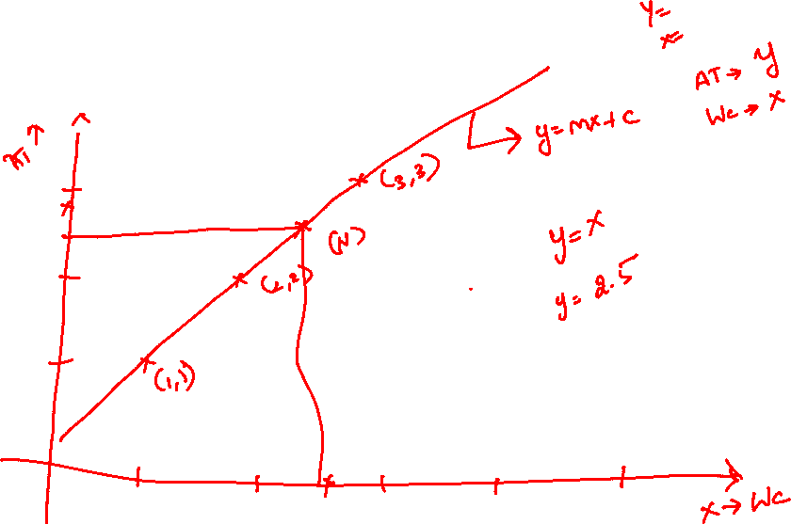
Linear Regression

Slide 5
Steps in M/L
Data
EDA
Feature Engineering
Split the data into two (train / test ) (80:20)
Model the data (train)
Evaluate the model (Test)
Choose the best model
Deployment

Slide 6
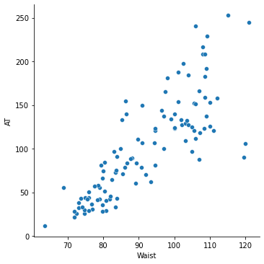


Simple Linear Regression

Slide 7

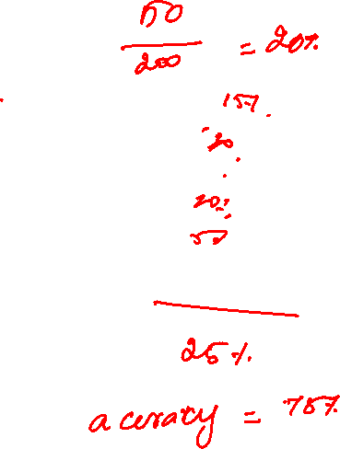




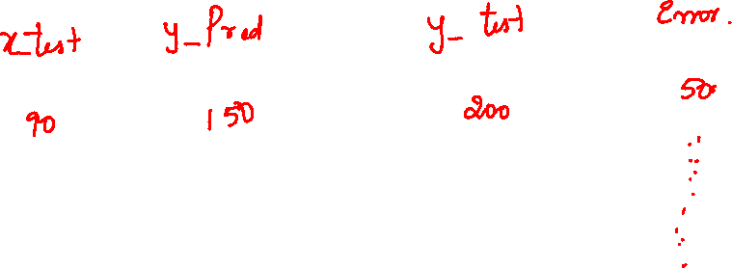

Slide 8
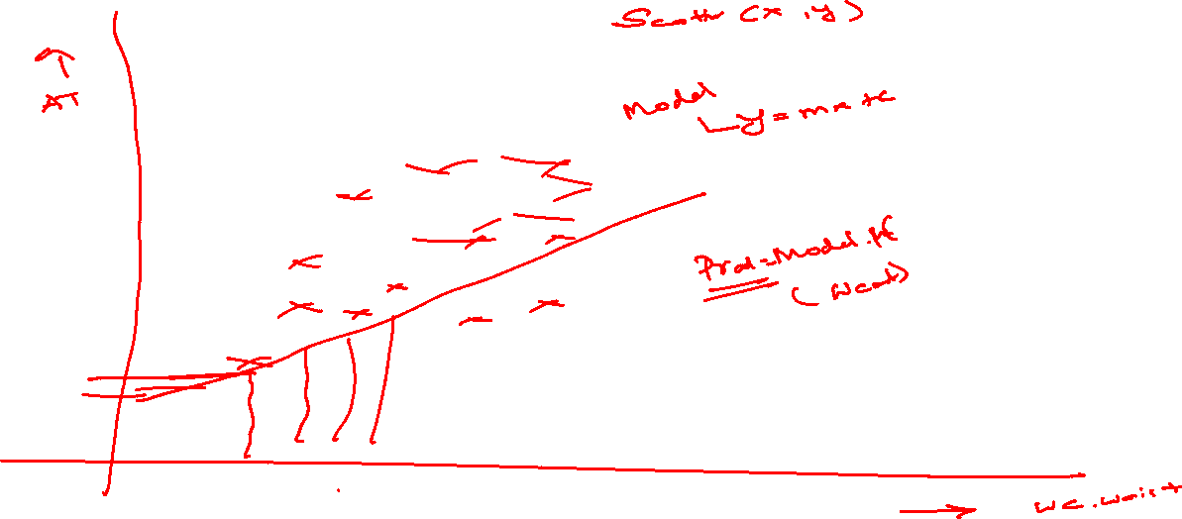

Slide 9
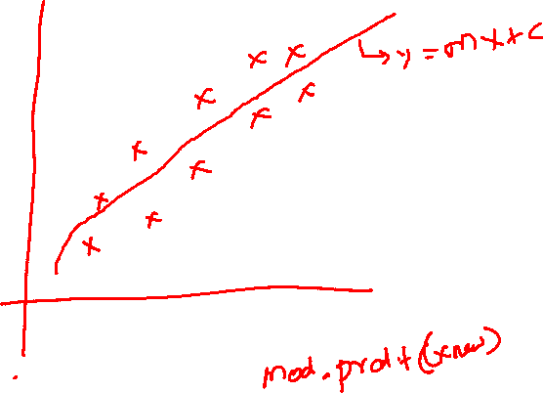


Slide 10
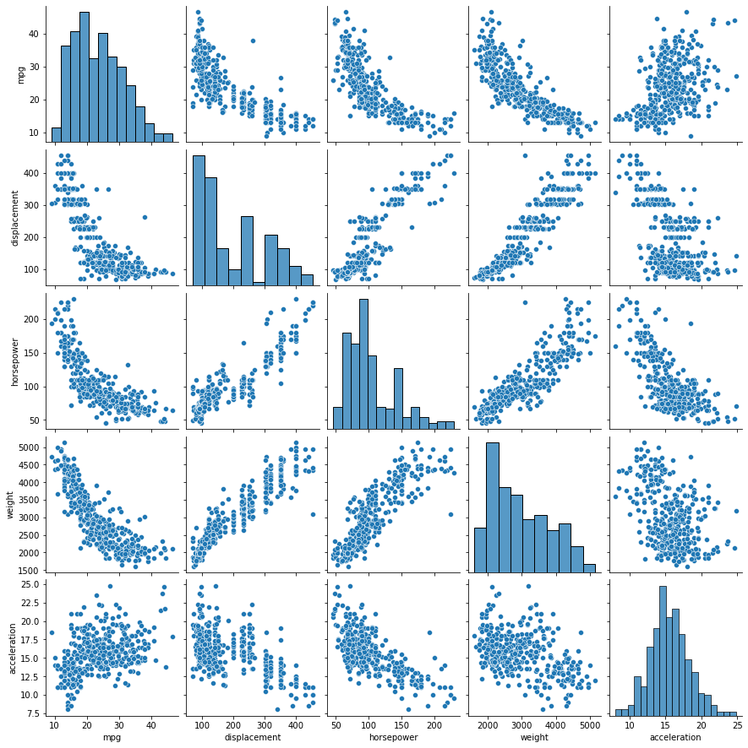
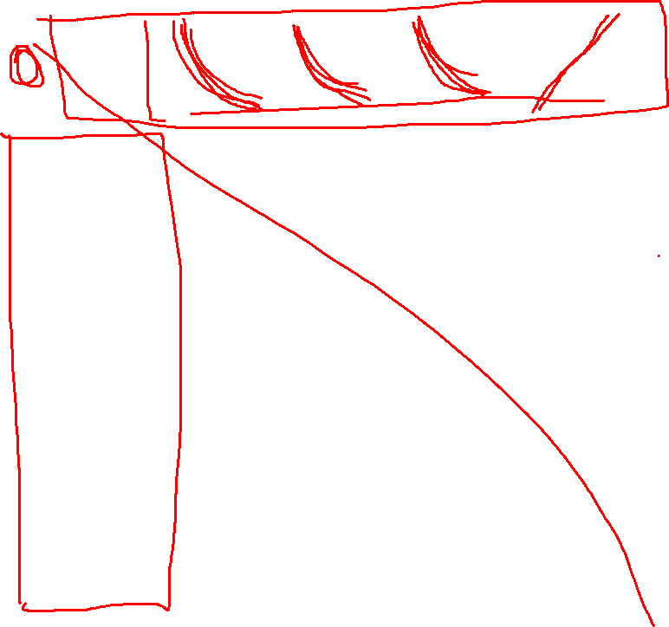

Slide 11
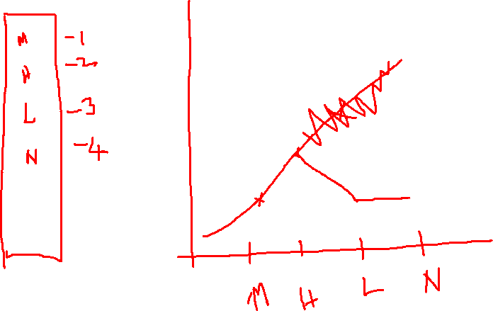

Slide 12
